Slide 1
Big Mountain Skiing Resort
(Guided Capstone Presentation)
By: Yevheniya Shevchenko

Slide 2

What are the problems?
Not maximizing returns relative to their competitors in the market
Missing key understanding of popular facilities that could improve profits

Slide 3
Recommendations to Consider
Permanently closing 10 of the least used runs
Installing a chair lift for a new run that has a vertical drop of 150 feet lower down
Same as number 2, but also adding 2 acres of snow making cover
Increasing the longest run by 0.2 miles to boast 3.5 miles, with 4 acres of snow making coverage
Key Finding:
Random forest was the model of choice

Slide 4
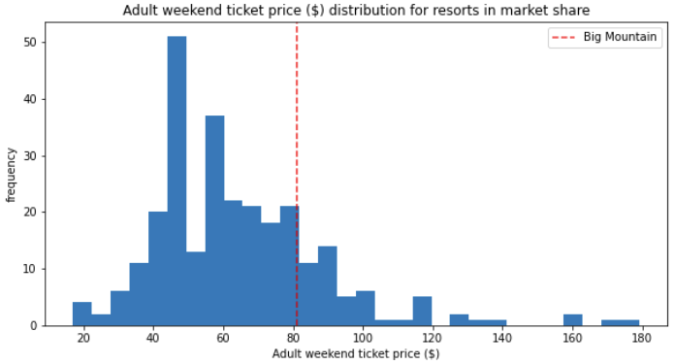
Big Mountain currently charges $81 for tickets, but it is still low compared to other resorts with similar facilities, based on the model the ticket price should be $95.87.

Slide 5
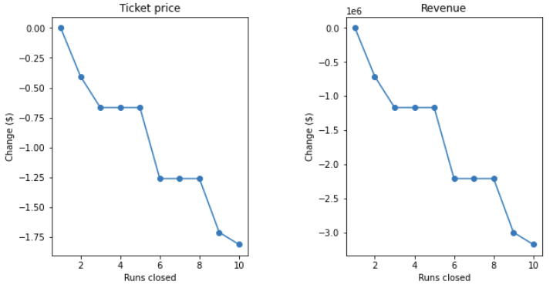
Random Forest Modeling
First order of business would be to only close 5 of the least used runs to lower operating expenses

Slide 6
Modeled Business Options
Scenario #2: Opening a new run with a 150 vertical drop down & chair lift improves ticket price by $8.61 to $1.5 billion seasonally
Scenario #3: Doing the same things, but also increasing 2 acres of snow making coverage improves the ticket price by $9.90 to $1.7 billion seasonally
Scenario #4: An increase in the longest run has no difference in ticket price since in the hierarchy of features for this model, longest run is lower in importance

Slide 7
Conclusion
350,000 visitors are expected this season on average visitors purchase 5 day passes
The most substantial finding through the random forest model would be to add a run with a 150 vertical drop down and install a new chair lift
With the snow making cover the ticket price would be greater, but the 2 acres would require more snow and maintenance that would lower returns
Why Scenario #2?
The new run fits the criteria of what visitors have consistently paid more for based on our data analysis of the market, even though the chair lift will be a large expense the estimate that visitors will purchase 5 day passes will help pay it back with the $8.61 ticket price increase

